Slide 1
The Rise of Nationalism
In
Europe

Slide 2
The Rise of Nationalism in Europe
RECAP
Who founded the Young Italy?
Why did the weavers in Silesia rise up in revolt?
What does the term das volk mean?
State one benefit of zollverein or the customs union.

Slide 3
The Rise of Nationalism in Europe
UNIFICATION OF BRITAIN
No revolution – long process
No British nation before 18th century
English, Welsh, Scots, Irish
English nation grew in wealth and power
1688 – British Parliament seized power from the king
1707 – England & Scot formed the UK of GB
Scotland’s identity was suppressed and faced terrible repression
Ireland – UK divided the Catholics and Protestants
1801 – Ireland was forcibly incorporated into UK
A British nation was forged – British flag, national anthem, the English language were actively promoted

Slide 4
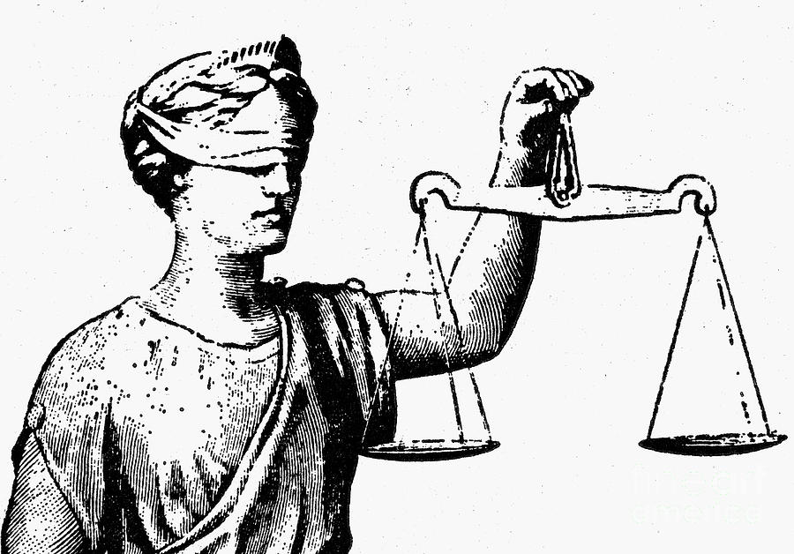
The Rise of Nationalism in Europe
Allegory

Slide 5
The Rise of Nationalism in Europe
What do you understand by ‘allegory’?
When an abstract idea (example, greed, feedom, liberty, justice)
is expressed through a person or a thing.

Slide 6
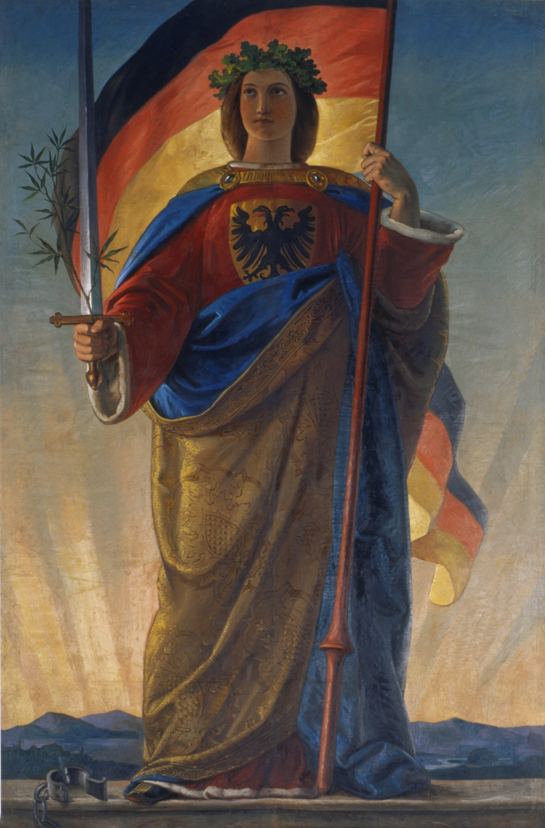
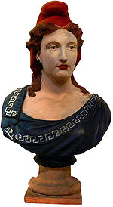
The Rise of Nationalism in Europe
Germania Marianne
Germany and France

Slide 7
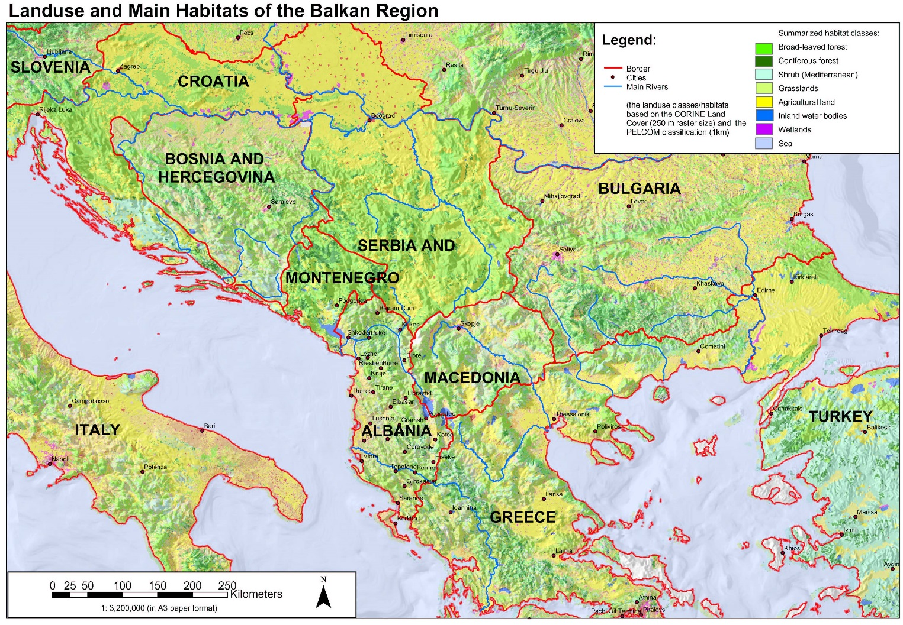
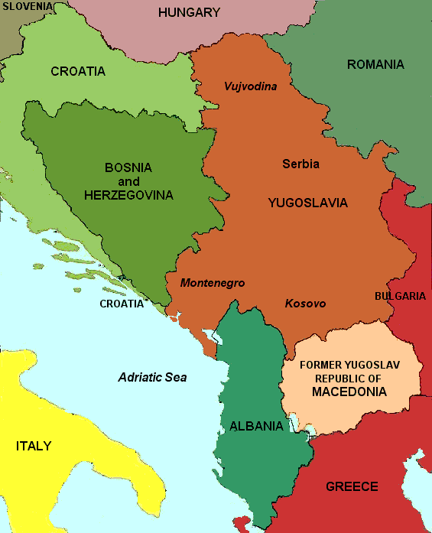
The Rise of Nationalism in Europe
BALKAN CRISIS

Slide 8
The Rise of Nationalism in Europe
BALKAN CRISIS
The Balkans issue was an important step towards WWI.
Austria-Hungary was worried by the sudden rise of Serbia.
A-H's ally, Germany was also concerned about what it saw as a Russian satellite state.
Serbia's rise in power thus contributed to the two Central Powers' willingness to risk war.
Austria-Hungary had a massive empire and due to various treaties and military victories. They administered the government of Serbia.
Serbia didn't like this and there was a strong underground movement to gain independence.
The heir to the A-H empire (Franz Ferdinand) had wanted to visit the Serbian capital on what we might call a PR exercise. CONTD: next slide

Slide 9
The Rise of Nationalism in Europe
BALKAN CRISIS
Due to a series of mistakes and a lot of random luck on behalf of the assassins, the archduke was killed and A-H decided to use this opportunity to take full control of the country.
A-H told Serbia to surrender some freedoms and liberties or be occupied.
Russia told A-H to back off or face war. Germany did not listen.
France told Germany to back off or face a war.
A-H called every one bluff and invaded thus led the others to declare war.

